Slide 1
New York City Crime
Report Analysis
Submitted by:
Shivi Jain

Slide 2
Project overview
Showcasing analytical capabilities of Python language including:
Data import
Data cleaning
Descriptive data analysis
Exploratory data analysis via visualizations
Predictive modeling
Model Evaluation
Project Goal:
To produce analytical results which can contribute to making the city of New York a safer place to visit, work or live.

Slide 3
About the dataset
New York City Crime Report Data
Each record represents a criminal complaint in the New York City
Includes all valid felonies, misdemeanors, or violations reported to the New York City Police Department (NYPD)
Data entries are from Jan 2023 to March 2023.
36 column variables and over 1.3 lakh records.

Slide 4
Analytical tools used
Language: Python
IDE: Jupyter Notebook and Spyder
Libraries:
pandas
numpy
seaborn
matplotlib
plotly
LabelEncoder
Sklearn

Slide 5
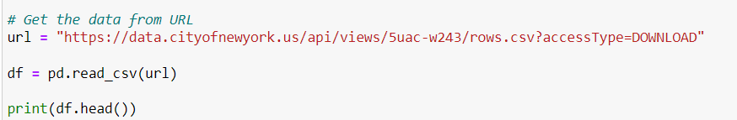
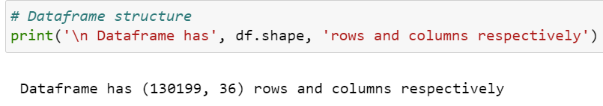
Data import
Since data is imported directly from the URL, the models will always show relevancy with time.

Slide 6
New York City Crime Report Analysis data cleaning
Removed unwanted columns from the data frame
Checked null values and replaced them
Changed variables to appropriate datatype and filter records for 2023
Removed timestamps from date column
Removed minutes and hours from time column to use it in visualization
Replaced null values under ‘suspect gender’ with Unknown
Rename the columns
Transform Age group of the suspect and the victim into correct age group label

Slide 7
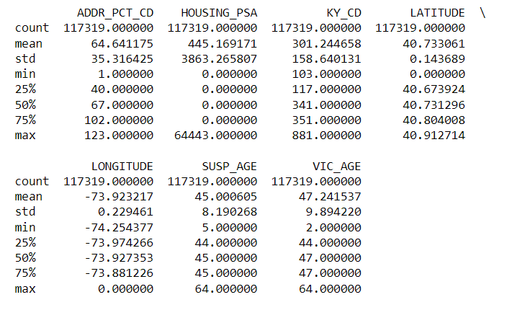
New York City Crime Report Analysis descriptive analysis
The average age of suspects is 45 years
The average age of victims is approximately 47 years

Slide 8

Data Visualization

Slide 9
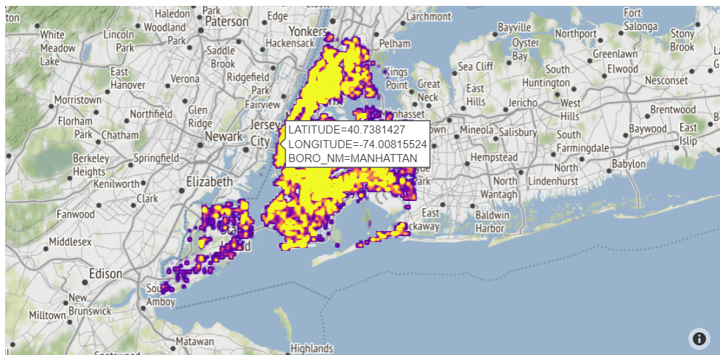
New York City Crime Report Analysis
Which have been the most unsafe locations in 2023 within the city of New York?
Yellow regions are the most unsafe while Purple regions are the safest.
Bronx, Queens, Manhattan, and Brooklyn are the areas with the most number of reported cases.

Slide 10
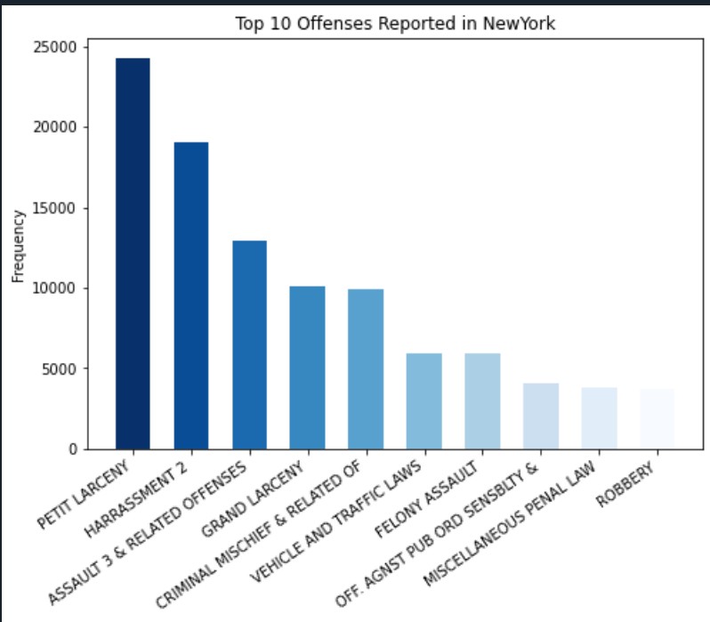
New York City Crime Report Analysis
What are the top 10 offenses reported in New York city in 2023?
Petit larceny and Harassment are the most common crimes in the city with about 24,500 and 19,000 cases, respectively.
Robbery is the least likely to occur.

Slide 11
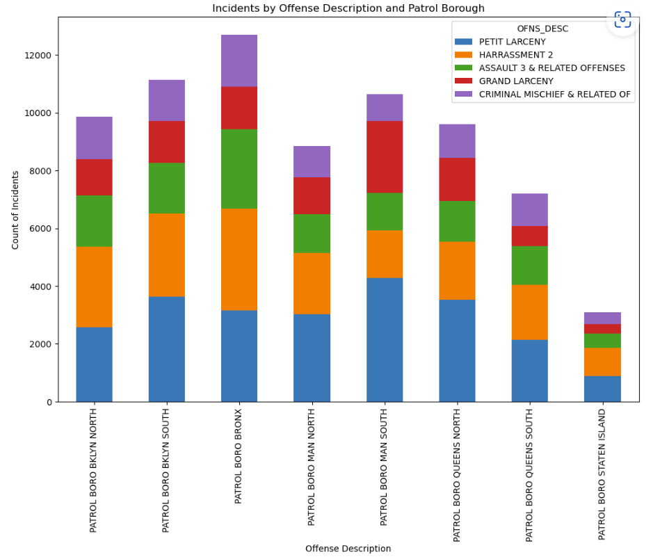
New York City Crime Report Analysis
How are frequencies of the top 5 crimes distributed within each of the 8 patrol boroughs?
The crime incidents are most common in the patrol borough of the Bronx.

Slide 12
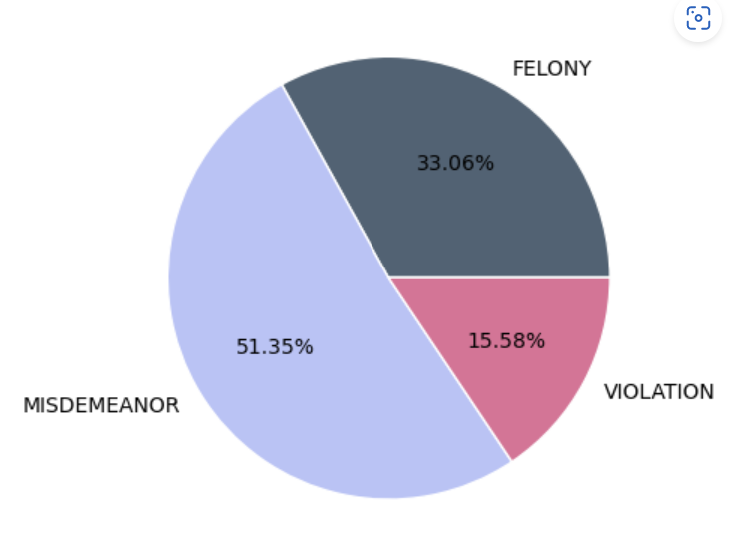
New York City Crime Report Analysis
What is the proportion of each law category for the crimes being reported?
More than 51.35% of crimes are Misdemeanors, while 33.06% are cases of Felony

Slide 13
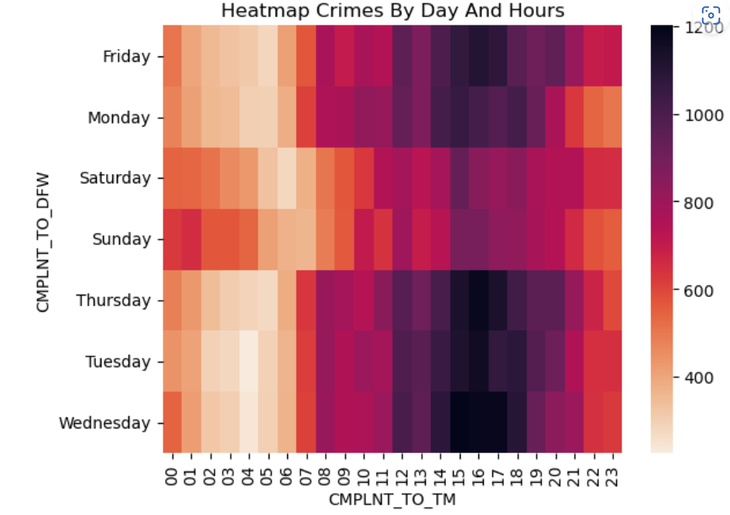
New York City Crime Report Analysis
On what days and times is it most likely for a crime to occur in New York City?
The crimes in the city are most likely to occur on a weekday between noon to 6 pm.

Slide 14
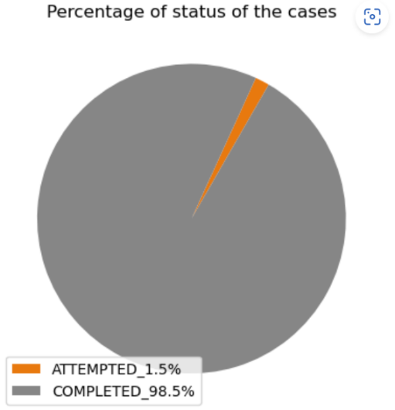
New York City Crime Report Analysis
What proportion of crimes has been solved by now?
More than 98.5 percent of the cases are Completed by the NYPD.

Slide 15
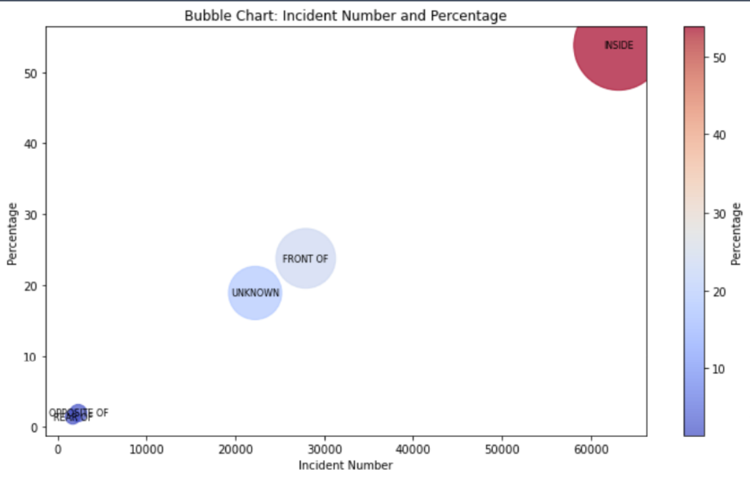
New York City Crime Report Analysis
Where are the most crimes taking place with respect to the police precincts?
Most of the crime incidents happen inside the police precincts.

Slide 16
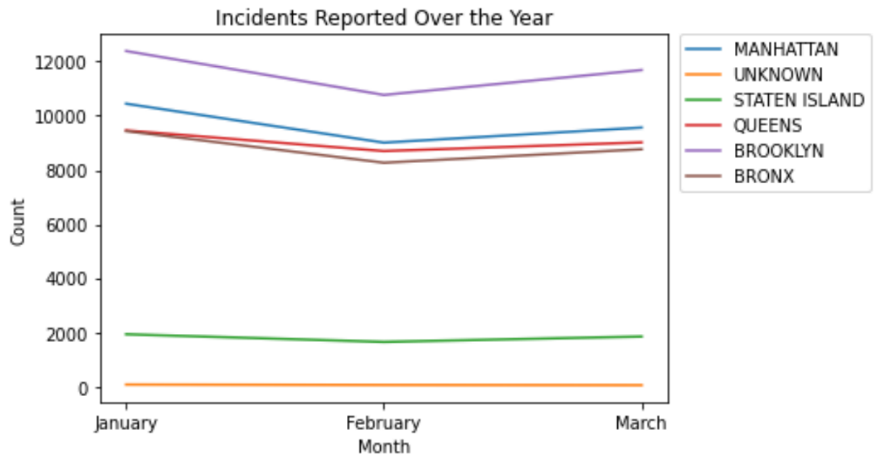
New York City Crime Report Analysis
What has been the trend of the crime incidents reported over the last three months in the 5 boroughs of the city?
The incidents all over the city took a dip in February.
The most crime incidents take place in Brooklyn and least in Staten Island.

Slide 17
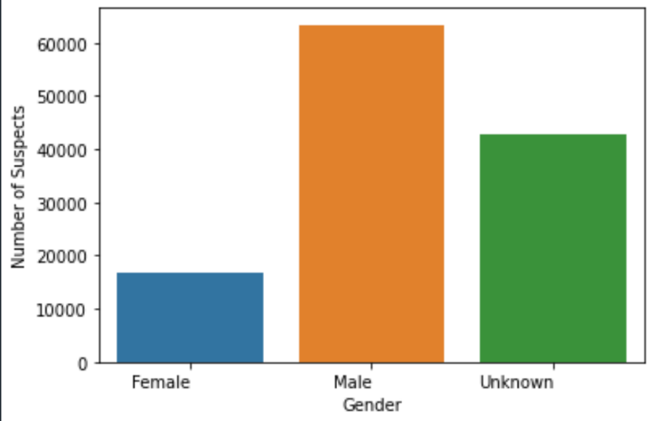
New York City Crime Report Analysis
Which gender do the suspects belong to the most?
There are far more Male suspects than Females.
Male suspects are approx. 4 times more than the Female suspects.

Slide 18
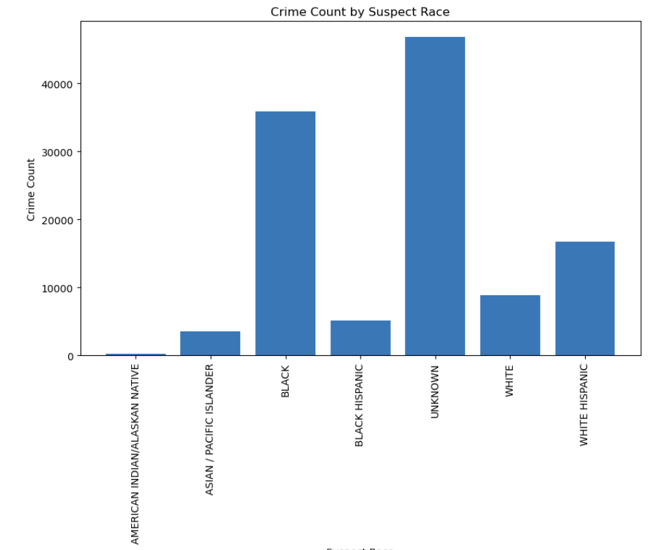
New York City Crime Report Analysis
Which race do suspects belong to the most?
Mostly the race of the suspects are unknown in the reports.
There are greater number of suspects from the Black Community in the city. Followed by White Hispanics.

Slide 19
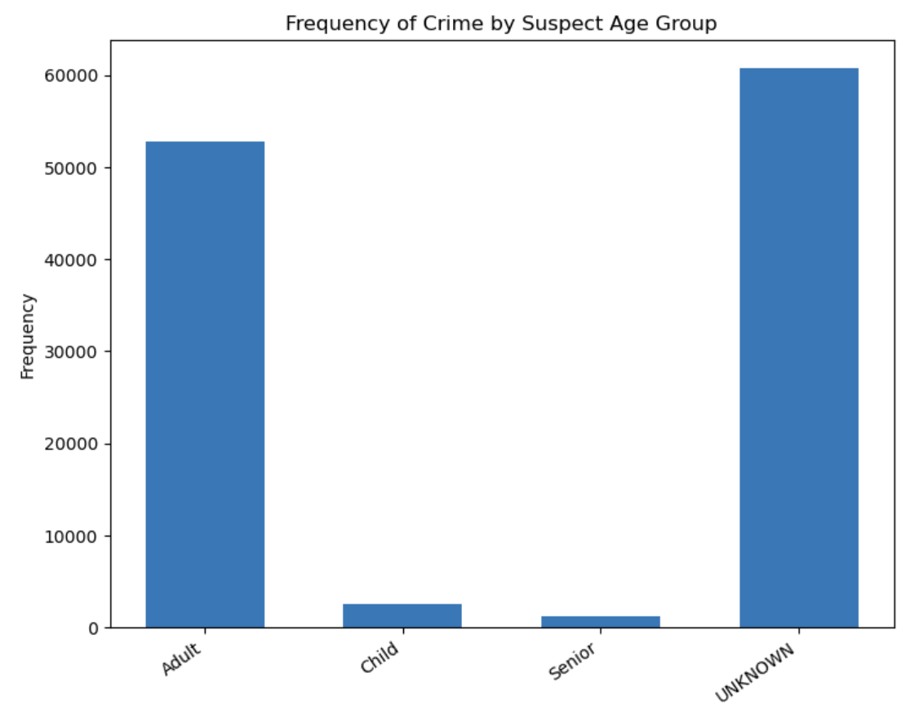
New York City Crime Report Analysis
What age group do most suspects belong to?
The age group of most suspects were unknown yet evidently most of them were Adults.

Slide 20
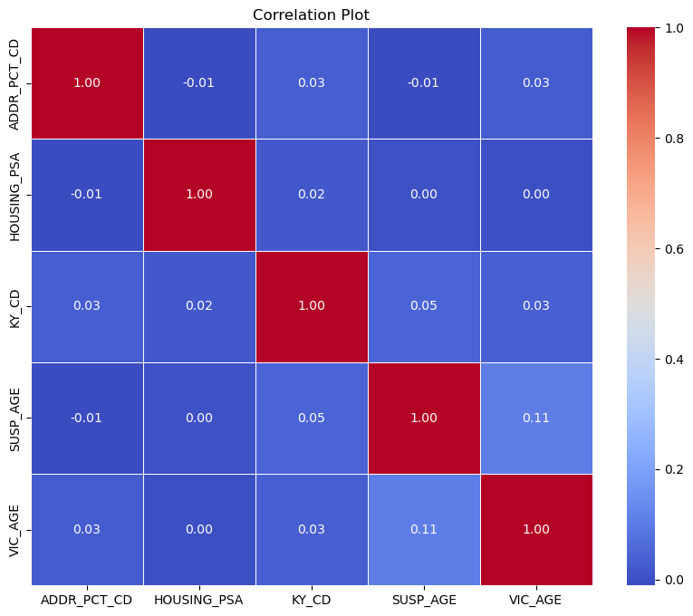
New York City Crime Report Analysis
How are the chosen variables correlated?
This is a correlation matrix showing correlations between all the variables chosen for analysis.
The encoded string variables show little to no significant correlation with each other.

Slide 21
Prediction Models

Slide 22
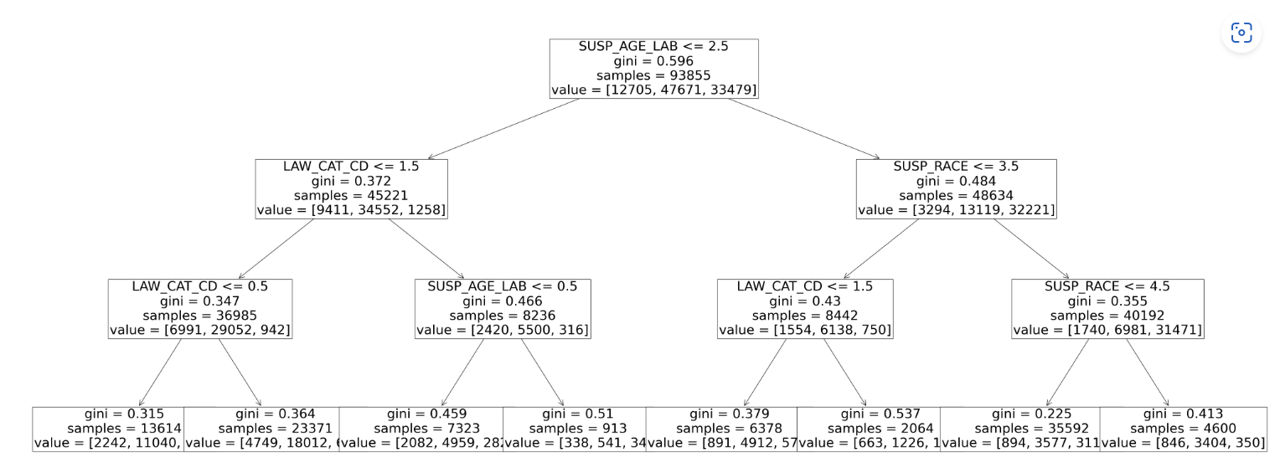
New York City Crime Report Analysis
The Decision Tree model: Predicting suspect gender

Slide 23
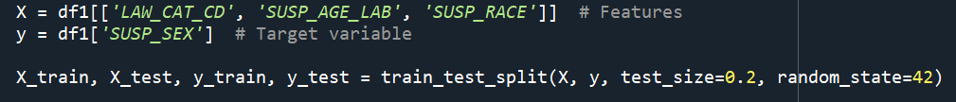
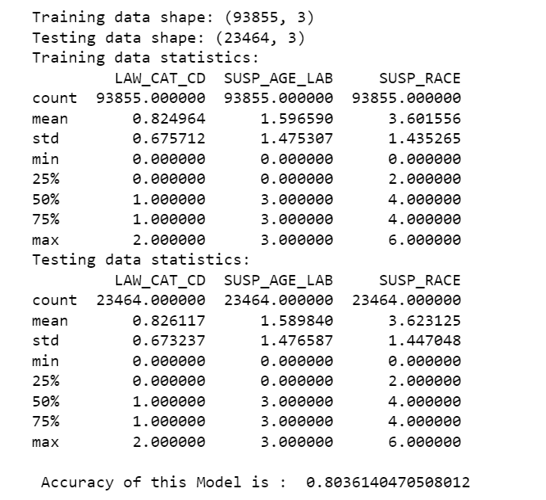

New York City Crime Report Analysis
The Decision Tree model: Accuracy level

Slide 24
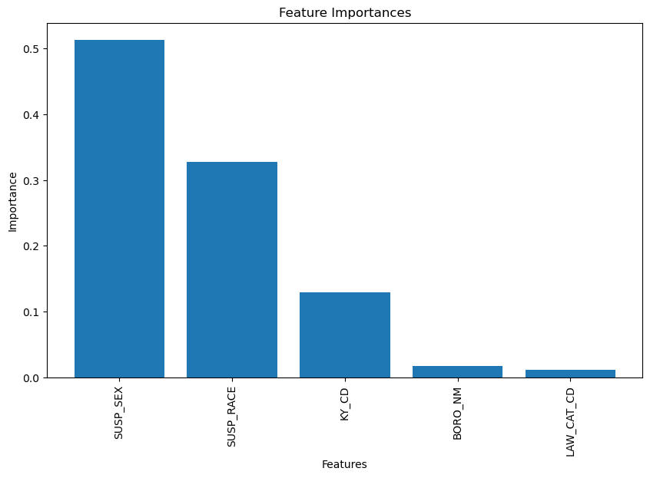
New York City Crime Report Analysis
Random forest model: Feature selection

Slide 25
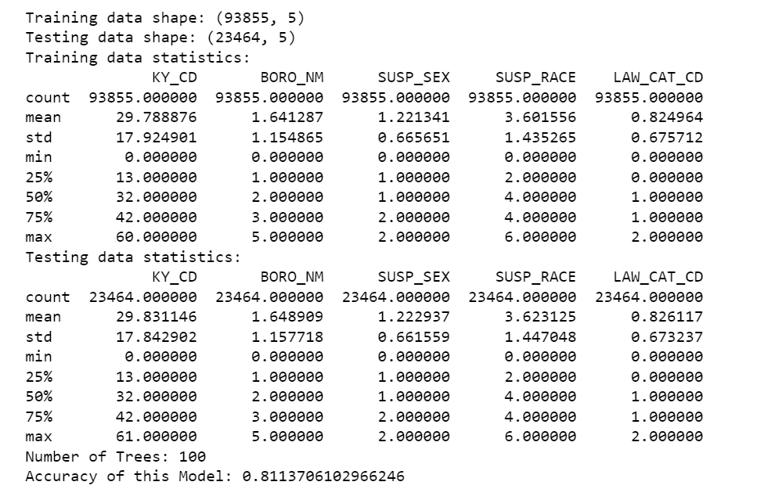

New York City Crime Report Analysis
The Random Forest Model: Accuracy level

Slide 26
conclusion
Most of the suspects and the victims are middle-aged adults involved in crime incidents around New Yor City.
Most crimes occur in Brooklyn and the patrol borough of the Bronx.
Most crime incidents occur inside the police precincts.
Most of the suspects are adults from the ‘black’ and ‘white Hispanic’ race.
Most crimes are either Petit larceny or Harassment and more than 50% of the crimes fall under the law category of ‘Misdemeanor’.
98.5% of the reported cases are closed by the NYPD.
Crime reports took a dip in February across the 5 boroughs within NYC.
Most crimes are reported on weekdays between noon to 6 pm.
There is no significant correlation between the variables, however, one can predict the gender of the suspect with an 80% accuracy level, using the decision tree model.
The random forest model gives us ‘suspect sex’ and ‘suspect race’ as the two most influential features in predicting the age group of the suspect, with 81% accuracy.

Slide 27
References
1.10. Decision Trees. (n.d.). Scikit-learn. https://scikit-learn.org/stable/modules/tree.html
Admin. (2023). Pandas Filter DataFrame Rows on Dates. Spark by {Examples}. https://sparkbyexamples.com/pandas/pandas-filter-dataframe-rows-on-dates/#:~:text=Filter%20Rows%20by%20Dates%20in%20pandas%20DataFrame
Bubble. (n.d.). https://plotly.com/python/bubble-charts/
Chauhan, N. S. (n.d.). Decision Tree Algorithm, Explained - KDnuggets. KDnuggets. https://www.kdnuggets.com/2020/01/decision-tree-algorithm-explained.html
Coder, R. (2022). Stacked bar chart in matplotlib. PYTHON CHARTS | the Definitive Python Data Visualization Site. https://python-charts.com/part-whole/stacked-bar-chart-matplotlib/
Heatmaps. (n.d.). https://plotly.com/python/heatmaps/
Koehrsen, W. (2019, December 10). Random Forest in Python - Towards Data Science. Medium. https://towardsdatascience.com/random-forest-in-python-24d0893d51c0

Slide 28
Thank you!

